Slide 1
Staying within the Riverbanks: Flowing Toward Success
Judy Keen
Garrett Smith
Notes:
Both Judy and Garrett introduce themselves here.

Slide 2
Devotional
“Don’t shine so others can see you. Shine so that, through you, others can see Him.” - C.S. Lewis
Notes:
Judy
Gives the devotion here

Slide 3
In Kairos, the Riverbanks create a powerful, purposeful flow for our Weekends.
It is the responsibility of leaders to implement and present the Kairos programs as they have been designed to flow through the Riverbanks.
Notes:
Garrett:
The metaphor of a riverbank is also deliberate: rivers can be wide in some places and narrow in others, and when we’re trying to navigate the river, it’s important for us to know when we have a lot of room for creativity - when the riverbanks are broad - and when we don’t have much room at all. There are similar principles in Kairos: there are certain aspects of the ministry where we have room to try something new, and there are aspects of the ministry where we need to follow the guidelines exactly. It’s important for us - and for the teams that we serve on - to understand when the riverbanks are wide, and when they are narrow.
When we talk about the riverbanks in Kairos team meetings, I think there’s a tendency to explain what they are, and then stop. That’s a good start, but it’s also important to understand why the riverbanks matter, and I think that this is important to convey to all the members of any Kairos team these reasons. Here’s a way of illustrating this that I think most of us have probably seen:
Quite a few of the team members that I’ve worked with in the past have their own ideas about how they want the weekend to be conducted: for example, for a few of the Kairos Inside teams that I worked, I was on the music team with one volunteer who always wanted the team to bring in guitars in on Thursday night so we could start with music. For any of you that have been on a Kairos Inside weekend, I’m sure you’re aware that we don’t start with music on Thursday night.
When he asked if we could bring in guitars, the answer was always “no, because the manual says not to,” but I think all of us know that’s not a terribly satisfying answer. What’s better is to explain why we do those sorts of things. I think, in general, it’s going to be easier to convince volunteers to follow the riverbanks if they understand why those riverbanks are in place.

Slide 4
What Are the Riverbanks?
In Kairos, the Riverbanks are the structures that create a powerful, purposeful flow. Without them, our ministry loses its direction and becomes stagnant.
Think of the Riverbanks as the “essential concepts” for Kairos. They’re the accumulated wisdom of the last 50 years.
They’re in the manual because they’ve been shown to work.
Notes:
Garrett:
The metaphor of a riverbank is also deliberate: rivers can be wide in some places and narrow in others, and when we’re trying to navigate the river, it’s important for us to know when we have a lot of room for creativity - when the riverbanks are broad - and when we don’t have much room at all. There are similar principles in Kairos: there are certain aspects of the ministry where we have room to try something new, and there are aspects of the ministry where we need to follow the guidelines exactly. It’s important for us - and for the teams that we serve on - to understand when the riverbanks are wide, and when they are narrow.
When we talk about the riverbanks in Kairos team meetings, I think there’s a tendency to explain what they are, and then stop. That’s a good start, but it’s also important to understand why the riverbanks matter, and I think that this is important to convey to all the members of any Kairos team these reasons. Here’s a way of illustrating this that I think most of us have probably seen:
Quite a few of the team members that I’ve worked with in the past have their own ideas about how they want the weekend to be conducted: for example, for a few of the Kairos Inside teams that I worked, I was on the music team with one volunteer who always wanted the team to bring in guitars in on Thursday night so we could start with music. For any of you that have been on a Kairos Inside weekend, I’m sure you’re aware that we don’t start with music on Thursday night.
When he asked if we could bring in guitars, the answer was always “no, because the manual says not to,” but I think all of us know that’s not a terribly satisfying answer. What’s better is to explain why we do those sorts of things. I think, in general, it’s going to be easier to convince volunteers to follow the riverbanks if they understand why those riverbanks are in place.

Slide 5
The metaphor of a river is helpful - like a real river, sometimes the riverbanks are wide, and sometimes they are narrow.
In our team formation meetings, it’s important to explain what the Riverbanks are, but we can’t stop there: we also want our participants to understand the reasons behind the Riverbanks.
We can use the Riverbanks to explain why certain things in Kairos are in place. This can help with compliance with the program!
Notes:
Garrett:
The metaphor of a riverbank is also deliberate: rivers can be wide in some places and narrow in others, and when we’re trying to navigate the river, it’s important for us to know when we have a lot of room for creativity - when the riverbanks are broad - and when we don’t have much room at all. There are similar principles in Kairos: there are certain aspects of the ministry where we have room to try something new, and there are aspects of the ministry where we need to follow the guidelines exactly. It’s important for us - and for the teams that we serve on - to understand when the riverbanks are wide, and when they are narrow.
When we talk about the riverbanks in Kairos team meetings, I think there’s a tendency to explain what they are, and then stop. That’s a good start, but it’s also important to understand why the riverbanks matter, and I think that this is important to convey to all the members of any Kairos team these reasons. Here’s a way of illustrating this that I think most of us have probably seen:
Quite a few of the team members that I’ve worked with in the past have their own ideas about how they want the weekend to be conducted: for example, for a few of the Kairos Inside teams that I worked, I was on the music team with one volunteer who always wanted the team to bring in guitars in on Thursday night so we could start with music. For any of you that have been on a Kairos Inside weekend, I’m sure you’re aware that we don’t start with music on Thursday night.
When he asked if we could bring in guitars, the answer was always “no, because the manual says not to,” but I think all of us know that’s not a terribly satisfying answer. What’s better is to explain why we do those sorts of things. I think, in general, it’s going to be easier to convince volunteers to follow the riverbanks if they understand why those riverbanks are in place.

Slide 6
Training is Necessary
It is vital for our communities to train our volunteers on the Riverbanks.
The Riverbanks are our guide to correct the “But, we’ve always done it this way” in our communities.
Notes:
Judy:
I became involved in Kairos almost 20 years ago. My initial involvement was serving on two Weekends. By the time I was to serve on my third Weekend our Kairos Outside of Central Florida was closed down. For several years we had no Kairos Outside Weekends in Central Florida.
In 2013 I attended a reunion organized by a group who had been meeting and praying in hopes to restart Kairos Outside in Central Florida. We had just moved, I had free time and when they asked for volunteers, I said, “Yes.” Much to my surprise, the following week I got a call from that group that had been praying for this restart, asking me to be the Advisory Council Chair. I didn't even know there was such a thing as an Advisory Council!!
You see I had served on two teams and yet, as far as I could remember there had been nothing mentioned about Advisory Councils, or this thing called riverbanks.
It’s my understanding that the Riverbanks weren’t included in the Kairos Outside manual until 2011. Consequently when I served on those two Weekends and maybe the program may have had a different design. At any rate, I don’t even remember having a manual. So, when I became the Advisory Council Chair, there was much to be learned! I soon began to appreciate the value and benefit of the design of our programs as found in the manuals and laid out on the pages defining the riverbanks.
Unfortunately, some of the “Way we’ve always done it” carried over from those earlier Weekends and continue to be discovered by our Weekend Leaders. These discoveries have led to tension between the Leader, who was keeping us within the riverbanks and some of the team members who had served on earlier Weekends. These “traditions” had become meaningful to the team members, but were way outside the river, way up on the banks. In all these cases, the team had to be reminded, “It’s not about the team, it’s about the guests.”

Slide 7
We need to try to present the Riverbanks in a way that is interesting to team members. This can be a challenge!
Two important questions we need to answer:
  Why are the Riverbanks important, and how can we explain this to our volunteers?
  What are some ideas for how you can cover and explain the Riverbanks in interesting ways in team formation meetings? How can we get team members to pay attention?
Notes:
Garrett:
I think the story that Judy’s shared helps us emphasize covering the Riverbanks in our team formation meetings is so important.
Something else that I think that we’ve both noticed in team meetings is that some of our teams have trouble presenting the riverbanks creatively. I’ve been in quite a few meetings where the way that the riverbanks are presented is when some unfortunate volunteer reads them all to the group. (Like some of you, I’m sure, I have occasionally been that volunteer.) While the goal of covering the riverbanks is laudable, this method of covering them bores newcomers and veterans alike, and it doesn’t really help us cover why they’re important.
With that in mind, I think it makes sense to talk about two main points during this workshop:
Why the riverbanks are important, and
Ideas for how you can better convey this information to your fellow volunteers during team formation meetings.

Slide 8
Continuity Among Communities
Making sure that we are doing the same thing within every community protects the Kairos brand
The ministry is strengthened when we all mean the same thing when we say “Kairos”
Notes:
Garrett:
The riverbanks are one of the most important ways that we maintain continuity among our Kairos communities. This is important for inmates that may get transferred between institutions or may be re-incarcerated in states other than the one in which they first encountered Kairos. It’s helpful to think about Kairos as a brand, by thinking of what we expect from other brands. Every time I go into a Chick-Fil-A, I’m expecting roughly the same experience. It would be a problem for Chick-Fil-A if, the next time that I went, I was told that the Chick-Fil-A that I walked into had decided that they were tired of chicken, and instead were now only serving pork barbeque. This is going to be true even if this is great pork barbeque, and it’s going to be a problem not just for that Chick-Fil-A, but for all of them. After that experience, I’m not going to identify Chick-Fil-A with chicken anymore. The next time I decide that I want chicken for lunch, I might not go to Chick-Fil-A because I can no longer trust them to be serving what I expect. Or, I might decide that I want pork barbeque and go to a different Chick-Fil-A, and in that case I’m going to be disappointed that they don’t have it. What I think is important to understand here is (1) changing the menu is going to be a problem even if what you change the menu to is good, and (2) it’s not going to just be a problem for your Chick-Fil-A. It’s going to be a problem for all of the Chick-Fil-A’s. To think about how this is applicable with Kairos: think about a Kairos Inside that, for example, performs baptisms on Kairos weekends. Or, a Kairos Outside community that does SWAP groups completely outside of the riverbanks. This is going to be a big problem for everyone in this community that gets the wrong impression of what Kairos is, and when they start talking to other people - and they describe what they’ve seen as Kairos, then it’s going to be a problem for everyone.

Slide 9
Staying Within Kairos Wisdom
Making sure that we are doing the same thing within every community protects the Kairos brand
The ministry is strengthened when we all mean the same thing when we say “Kairos”
Notes:
Judy:
When we’re no longer in the riverbanks, we’re outside of what we can think of as Kairos wisdom - the traditions that we know have worked for 50 years. This can be thought of as analogous to a recipe: if I’m following the recipe for a dessert that I’ve had before, I should have a good idea of what it’s going to taste like. I have a favorite chocolate cake recipe and if we’re having special guests, you can be assured that I’m not going to change the recipe! You would never find me substituting the cinnamon with ginger or the cocoa with chocolate syrup. No, I want to have confidence that it’s going to be perfect, so no substitutes. On our Weekends we are aiming for excellence, and we want to serve the best! We can be assured of the best when we have followed the Kairos method by implementing and presenting the Kairos programs as they have been designed.

Slide 10
Maximize the Spiritual Impact
Making sure that we are doing the same thing within every community protects the Kairos brand
The ministry is strengthened when we all mean the same thing when we say “Kairos”
Notes:
Judy:
Our Kairos programs are all designed to have a spiritual impact on our guests, and we don’t want to get in the way of God’s purpose and plan by inserting our own plan that could take the focus away from His. As I mentioned we had a few things that carried over on our Kairos Outside Weekends as “We’ve always done it this way” but were outside the riverbanks. Most of these were things that our team members remembered nostalgically from their previous Weekends when they were guests or team members. They wanted that warm feeling they felt when they heard the bedtime story, or when they shared the picture and story of their incarcerated person. They didn’t understand that the focus is on the guests, not the team members. In all our programs the teams are there to serve, to be God’s hands and feet, to love, love and listen, listen.

Slide 11
Comparing the Riverbanks Between Kairos Programs
Ministry Foundations | Common Ground | Sacrifice & Obedience | Team Formation | The Institution | The Weekend - Spirit | The Weekend - Program | Spiritual Relationships | Continuing Ministry
Ministry Foundations | Common Ground | Sacrifice & Obedience | Team Formation | Kairos Outside Guests | The Weekend - Spirit | The Weekend - Program | Spiritual Relationships | Continuing Ministry
Ministry Foundations | Common Ground | Team Selection | Team Formation | Youth Facilities | Spiritual Focus* | The Weekend - Program | Spiritual Focus* | Continuing Ministry
Kairos Inside
Kairos Outside
Kairos
Torch
Notes:
Garrett:
If you compare the manuals, you’ll find that even the Riverbanks that look the same differ between programs. Here’s what I mean: all Kairos programs have a “Ministry Foundations” Riverbank, and those riverbanks accomplish similar things, but that looks different because the ministry is different. Here’s an example: one of those guidelines in the “Ministry Foundations” Riverbank in Kairos Inside is “Advocates for Christ, not for Prisoners.” That doesn’t show up in Kairos Outside manuals; it’s not really needed. So when we talk about these riverbanks, we’re going to be sure to talk about which program we’re pulling this from, so we don’t all get confused.
So, let’s discuss some specific riverbanks. Remember, one of the points that we mentioned earlier was that some riverbanks are narrow, and some of them are wide. For example, the actual weekend riverbanks are narrow, and they are broad regarding team meetings. As we go through these riverbanks, one of the things we’ll want to point out is if the riverbanks are narrow, or wide, and why. Something important to remember: when the riverbanks are broad, it’s important to do that, too. If we treat the riverbanks like they are narrow for team meetings, and everyone tries to stay in the center, it means that team meetings are going to be the same every time. When the riverbanks are broad, it doesn’t just mean that we can express our creativity, but it means that we need to try to express our creativity.
Be sure to emphasize that we are not covering all the riverbanks. Just doing a few of them in depth.

Slide 12
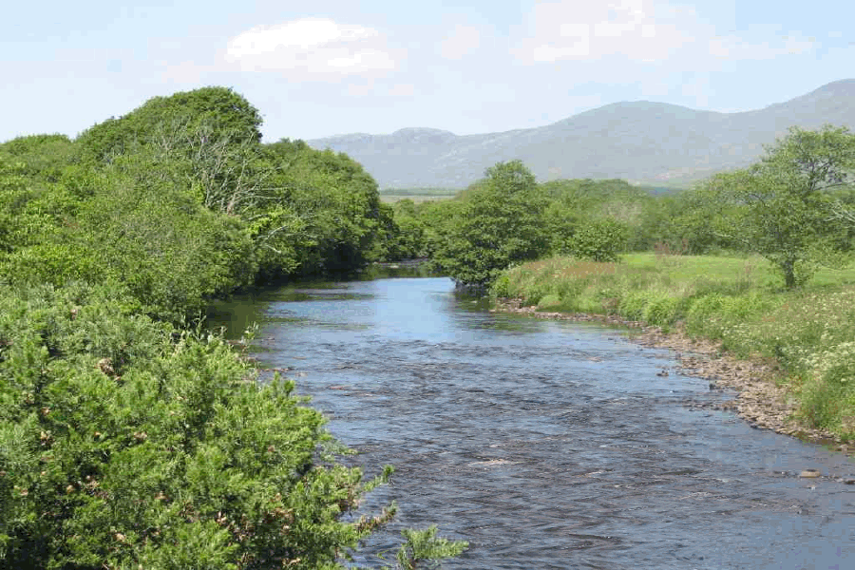

Ministry Foundations - Kairos Inside
Kairos is Love
Listen, Listen, Love, Love
Set Self
Aside
Prayer
is your foundation
Love those Conflicts
Agape is
love, not gifts
Kairos is a ministry of sacrifice
Advocates for Christ, not for Prisoners
Sacrifice your Agenda
Obedience is Conforming your will
Notes:
Kairos Inside: Ministry Foundations
Many of the guidelines here are similar between all three Kairos programs - in all our ministries, prayer is the foundation, we’re called to sacrifice our agenda, and listen, listen, love, love.
The riverbanks are important to enforce, but they’re going to look different from person to person. “Setting yourself aside” is good advice, but it’s going to look different from person to person.
Example of how this can go badly: I think we’ve all seen examples of Kairos volunteers that went in with their own agenda for the weekend. Imagine an entire team doing that!

Slide 13
Common Ground - Kairos Outside
Avoid activities that divide
Respect all church affiliations
Teach
common ground
Planting seeds through love
Lay our differences aside
Kairos is interdenominational
Anonymous loving servants
No communion in Kairos Outside
Unify in Christ
Avoid
criticism
Notes:
●Kairos Outside: Common Ground
○Our teams members come from many different denominations, but our focus on Kairos Outside is based on the two things as Christians we all have in common: Jesus is the One and the Bible is the Book.
○When we don’t stay within the Riverbanks, things can go badly:
■Focusing on denominational differences creates tension and distractions among team members.
■Guests too should be encouraged to stay on Common Ground.
oOn the Weekend staying within the Riverbanks, practicing Common Ground, gives our guests a vision of the Body of Christ, the Church where all are welcomed into a loving relationship with Christ.

Slide 14
Team Formation – Kairos Torch
Entire team reviews each talk
Mentor training required
Core Team meetings
Team meeting
#2 for #1 weekend
Stick to
the script
Vulnerability training required
Forty hours of team formation required
Preparing team for assignments
Kairos Torch team devotional guide
Notes:
Kairos Torch: Team Formation
This seems to be more narrow in Torch than it is with Kairos Outside or Kairos Inside.
Explain that this is one of the more broad riverbanks in Kairos Outside and Kairos Inside: weekend leaders are told what to cover, but not how to cover it. Creativity is important to make sure that team meetings don’t all seem the same.
Example: there are two possible errors that you can make: (1) if you have several weekend leaders in a row that treat this as if it is a narrow riverbank, you’re going to have bored volunteers, and (2) if you do not cover what you need to cover, then your team is not going to be prepared.

Slide 15
The Institution - Kairos Inside
Not on a visitation list
Don’t
smuggle anything
No glass or metal objects
Religious materials go through chaplain
Honor the warden’s authority
Don’t give anything to residents
Don’t mail letters for residents
Don’t purchase items from participants
Don’t pass messages
Notes:
Kairos Inside: The Institution
For Kairos Inside, quite a bit of this Riverbank is aimed at making sure that we follow institutional rules.
The riverbanks here may vary depending on your institutional rules, but the principles are the same. For example: we always have to honor the authority of the chaplain - that won’t change. However, your institution may have additional restrictions on what can be brought in.
To train this, it might be helpful to invite your team to discuss how this is applicable to your specific institution. (For example, is the team prohibited from bringing in paper, as well?)

Slide 16
The Weekend - Program - Kairos Outside
Lead us not into temptation
The river is narrow
Have faith -
it works
Saturday
Sunday
Celebrate the closing
Friday
evening
Everything in sequence
Nothing substituted
Notes:
Kairos Outside: The Weekend - Program 9
The riverbanks for all three Kairos programs here are narrow - in none of our programs are you allowed to modify the contents or the order of the weekend.
○ As I mentioned we had a few things that carried over on our Kairos Outside Weekends as “We’ve always done it this way” but were outside the riverbanks. Most of these were things that our team members remembered nostalgically from their previous Weekends when they were guests or team members. They wanted that warm feeling they felt when they heard the bedtime story, or when they shared the picture and story of their incarcerated person. They didn’t understand that the focus is on the guests, not the team members. In all our programs the teams are there to serve, to be God’s hands and feet, to love, love and listen, listen.

Slide 17
Continuing Ministry - Kairos Torch
Building mentoring relationships
Mentors can’t replace parents
Monthly reunions
Christian mentoring is
the focus
Kairos Torch Bible studies
The Kairos Torch mentor’s guide
Safeguards
after release
Complete mentor’s monthly checkups
Sending monthly check-ups to Kairos
Notes:
Kairos Torch: Continuing Ministry
Remember that this is going to look different between all three Kairos programs. With Kairos torch, the emphasis is on continuing to develop those mentor/mentee relationships. That’s a bit different than how continuing ministry works with Kairos Inside and Kairos Outside, and the riverbanks for Torch are probably a bit more narrow here than they are with other Kairos programs.

Slide 18



Use the Program Manuals to Train the Riverbanks!
Notes:
It is important that we keep our volunteers in the Manuals when training on the Riverbanks. Using additional resources and creative ideas to assist in the teaching of the Riverbanks can be a compliment but NEVER a replacement to the MANUAL. Learning to teach from the Manual helps the volunteers become familiar and comfortable with going to the manual to find the right answers to every problem that may arise! TRAIN FROM THE MANUALS FIRST AND FOREMOST!!!

Slide 19
Continuously Present the Riverbanks
Every new team needs to learn or review the Riverbanks. There are two goals for how we want to do this:
Present things in a way that the new people are given new information, and the veterans are not bored. We somehow have to engage both new people and veterans at the same time.
A goal here should be to make our team members think through the riverbanks, not just review what they are. (This can help with the first goal!)
Notes:
How to present the riverbanks during team meetings: there are a couple goals for how we want to do this:
Present things in a way that the new people are given new information, and the veterans are not bored. We somehow have to engage both new people and veterans at the same time.
A goal here should be to make our team members think through the riverbanks, not just review what they are. (This can help with the first goal!)

Slide 20
Group Discussion
What kind of questions can we ask participants to discuss?
What do you feel is the most important piece of advice within this riverbank topic?
Why do you feel that this guidance is important?
Can you imagine what would result for your Kairos team (or for Kairos in general) if no one followed this guidance?
Notes:
Garrett
Ideas for how this this can be done:
Break the team into groups. The number of groups should correspond to the number of riverbanks that you want to cover. Give the members of a group time to discuss a particular riverbank topic - and here we’re talking about one of the riverbank topics like “team formation” or “ministry foundations.” There are a couple different questions that you could ask them to discuss. You can one (or more) of these, or come up with your own:
What do you feel is the most important piece of advice within this riverbank topic?
Why do you feel that this guidance is important?
Can you imagine what would result for your Kairos team (or for Kairos in general) if no one followed this guidance?
The goal in this discussion is to encourage them to think through the “why” of the riverbank. It is a good rule of thumb to make sure that each group has both veterans and volunteers that are new to Kairos. Remember, we want to keep both veterans and new volunteers engaged, and one of the ways that we can do that is have veterans explain things to new volunteers.
At the end of this discussion, we can have the teams report back to the main group what they discussed and what they decided. The best questions that we ask people to discuss are open ended, and there are many possible good answers to something like “which riverbank is the most important.” However, if groups come back having decided that a riverbank isn’t important, or that there are no consequences for not following it, it’s best if someone in leadership jumps in to correct this.

Slide 21
Visual Aids
These can help spark conversation and remind team members of the importance of the Riverbanks.
Cards passed out to team members.
Team members find the Riverbank that corresponds to that card.
Teammates share their interpretation of that riverbank with a small group for feedback.
Notes:
Judy
Using visual aids to encourage discussion and having team members keep the riverbanks in the front of their minds. Have all the riverbanks written on small cards that are passed out to all the team members. The leader introduces them to the pages where the riverbanks are found in the manual and they are asked to find the one that corresponds to their card. They then talk about their riverbank, giving their interpretation, and getting feedback from their table mates. This is then followed by a leader who calls on the team member to share their card and their understanding of it. The leader can at that time add any points missed before going to the next person. (There are nine pages of riverbanks and can be divided into 3 or 4 pages per team meeting.)
Using visual aids to encourage discussion and having team members keep the riverbanks in the front of their minds. Have all the riverbanks written on small cards that are passed out to all the team members. The leader introduces them to the pages where the riverbanks are found in the manual and they are asked to find the one that corresponds to their card. They then talk about their riverbank, giving their interpretation, and getting feedback from their table mates. This is then followed by a leader who calls on the team member to share their card and their understanding of it. The leader can at that time add any points missed before going to the next person. (There are nine pages of riverbanks and can be divided into 3 or 4 pages per team meeting.)

Slide 22





Card Examples
Chapel is Holy Ground
It’s Not About You
Dress
Simply

Slide 23
Discussions Led by Leader
After a Riverbank is read from the manual, A leader can show a slide with the graphic of that Riverbank on it to bring even more focus to the discussion.
The following slides are some examples.
Notes:
Garrett, this is just an example if we want to include it and the following slides.

Slide 24
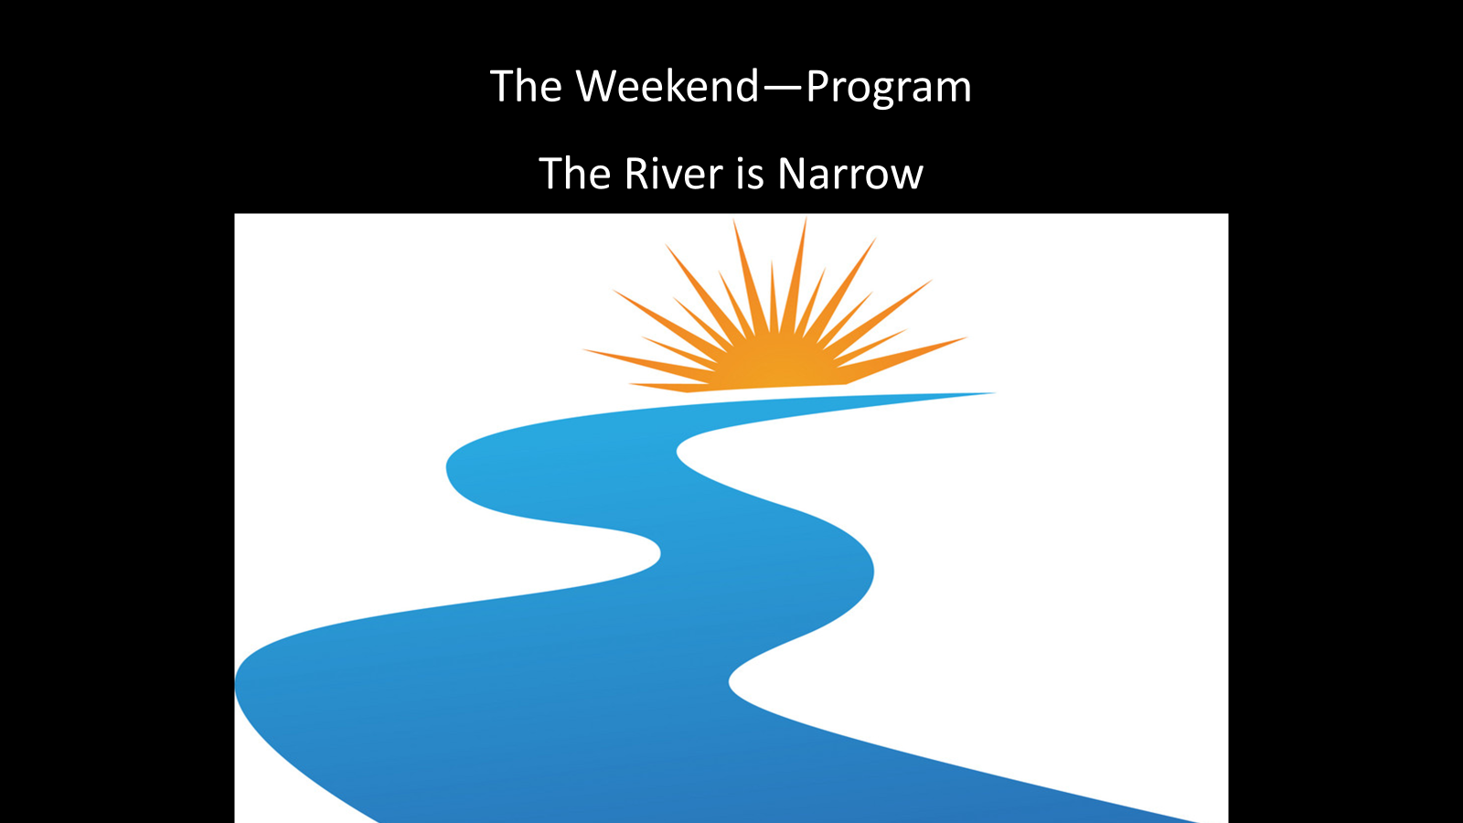

Slide 25
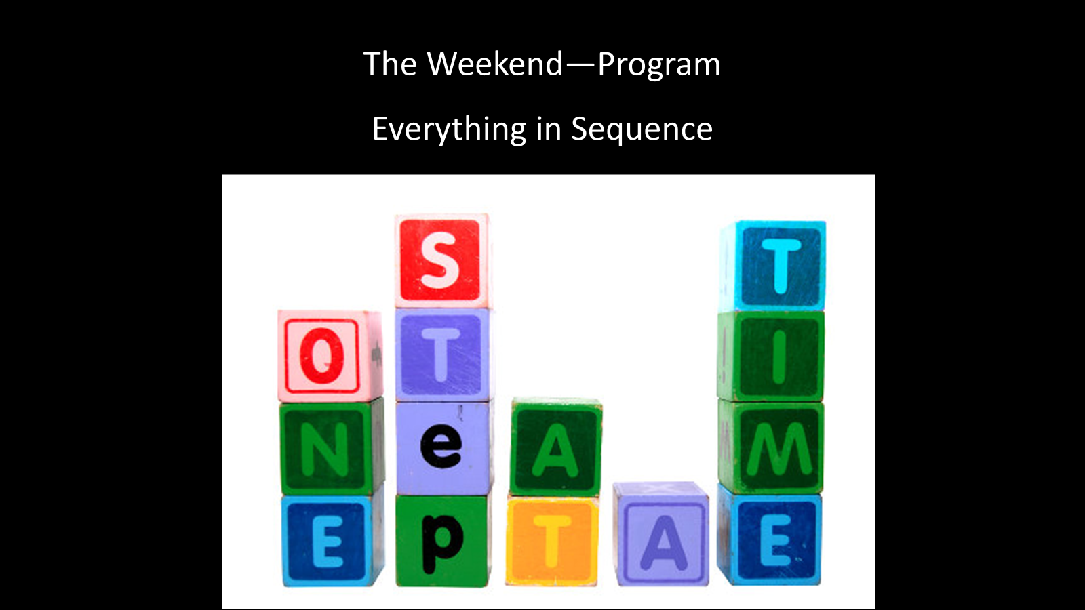

Slide 26
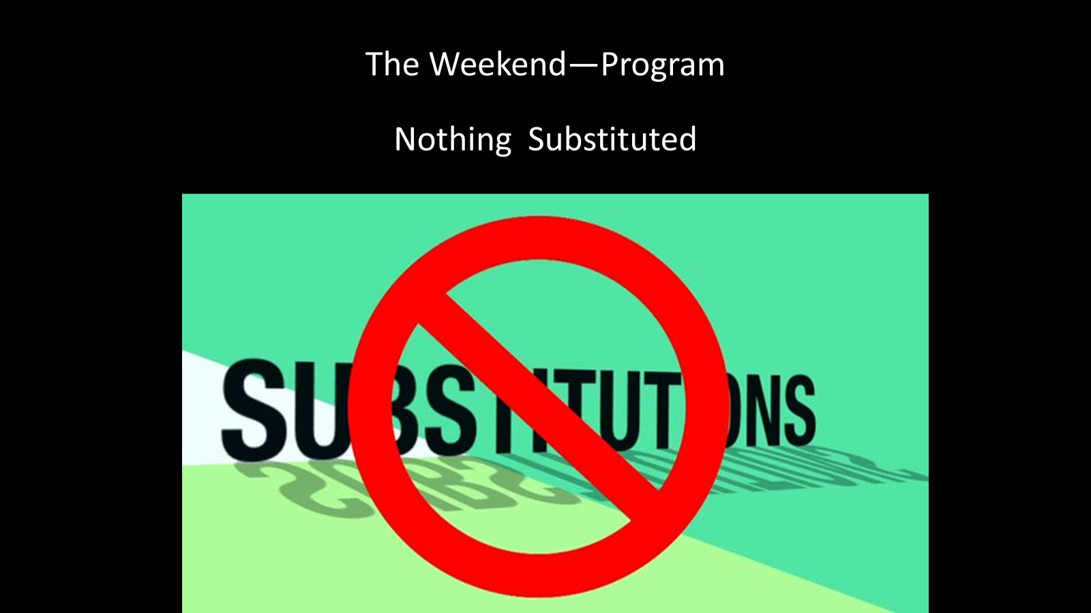

Slide 27


Slide 28


Slide 29
Skits
Can be used to demonstrate what happens when Riverbanks are or are not followed.
Make sure the positive advice is memorable!
Select skit participants with care.
Use them for points you wish to emphasize, it may not be an efficient use of time.
Notes:
Garrett
Ideas for how this this can be done:
Break the team into groups. The number of groups should correspond to the number of riverbanks that you want to cover. Give the members of a group time to discuss a particular riverbank topic - and here we’re talking about one of the riverbank topics like “team formation” or “ministry foundations.” There are a couple different questions that you could ask them to discuss. You can one (or more) of these, or come up with your own:
What do you feel is the most important piece of advice within this riverbank topic?
Why do you feel that this guidance is important?
Can you imagine what would result for your Kairos team (or for Kairos in general) if no one followed this guidance?
The goal in this discussion is to encourage them to think through the “why” of the riverbank. It is a good rule of thumb to make sure that each group has both veterans and volunteers that are new to Kairos. Remember, we want to keep both veterans and new volunteers engaged, and one of the ways that we can do that is have veterans explain things to new volunteers.
At the end of this discussion, we can have the teams report back to the main group what they discussed and what they decided. The best questions that we ask people to discuss are open ended, and there are many possible good answers to something like “which riverbank is the most important.” However, if groups come back having decided that a riverbank isn’t important, or that there are no consequences for not following it, it’s best if someone in leadership jumps in to correct this.

Slide 30
Discussion
Do you feel that the Riverbanks are being covered well in your communities?
What has worked in your communities?
How can you improve?

